Slide 1
Stanley X Hackathon
System for identifying, capturing, and organizing critical knowledge
Link
Vijay Balasubramaniam & Nithin Vijaykumar

Slide 2
Design Goals
Accessible - Works on any phone, tablet or computer
Simple - Provides an intuitive user experience
Incentive-driven - Provides all users with economic incentives to participate by contributing and curating high quality content
Extensible - Built using open source technologies that have robust community support and a thriving plugin ecosystem
Cost-effective - Uses serverless technologies where possible to minimize operating costs

Slide 3
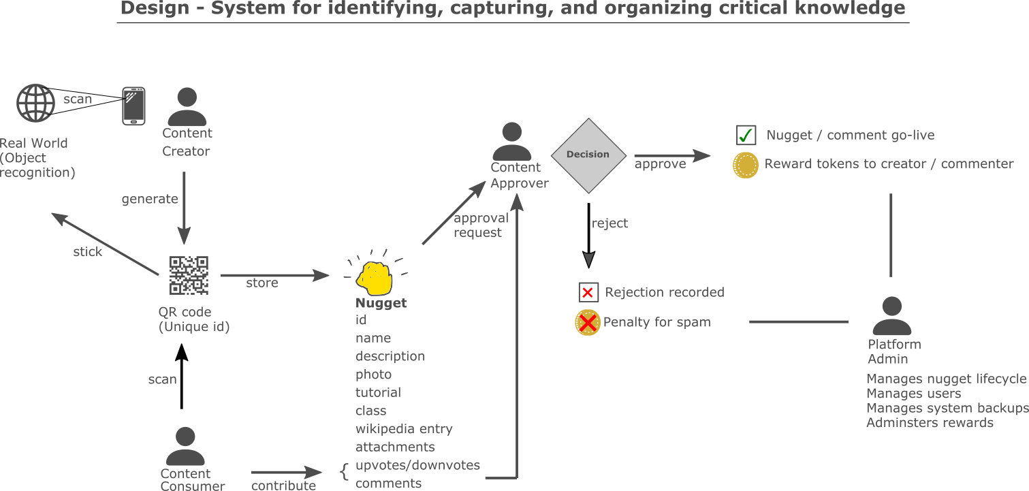

Slide 4
Capabilities
Minimum Viable Product
Core content management using Wordpress including text, video, attachments
Knowledge capture into a “nugget”, and retrieval using directory lookup and search
Physical workspace integration using QR code stuck to machines
User roles for content creator, consumer, approver and admin + approval workflow
Enhancements (roadmap)
Image recognition (AI) using Tensorflow and/or Cloud Vision
Reward system (gamification) to encourage positive contribution and discourage spam
Learning path tied to job roles across multiple manufacturing/distribution facilities
Credentials automatically unlock access to machines that require safety training

